Slide 1
Netflix Stock Rise
A comparative analysis of the value of Netflix Stock against the
Dow Jones Industrial Average

Slide 2
Netflix Stock Analysis
This presentation showcases an analysis of the performance of Netflix stock in 2017
Overall, Netflix stock steadily increased throughout the year, with performance generally meeting or exceeded analyst expectations
To best showcase this upward trend, we’ve included the following graphs:
A violin plot of quarterly stock price, which showcases the mean, median, and deviation of the price within a specific quarter
A scatterplot that shows actual earnings per share compared to analyst’s estimates
A bar chart illustrating the trend of Netflix’s earnings against its revenue for each quarter
A side-by-side comparison of Netflix’s stock performance against the Dow Jones Industrial Average, a good representation of market performance overall

Slide 3
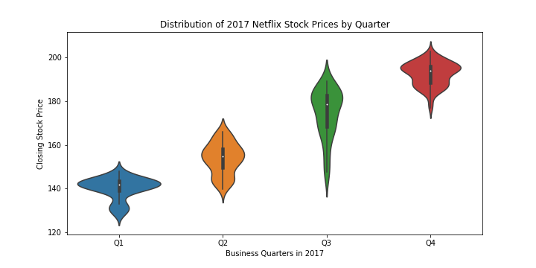
Distribution of 2017 Netflix Stock Prices
2017 saw a steady increase for Netflix stock price
Q1 and Q4 saw the largest fluctuations in stock price, while Q2 and Q3 say much less
Overall, Netflix’s stock price surged by almost 66% in 2017

Slide 4
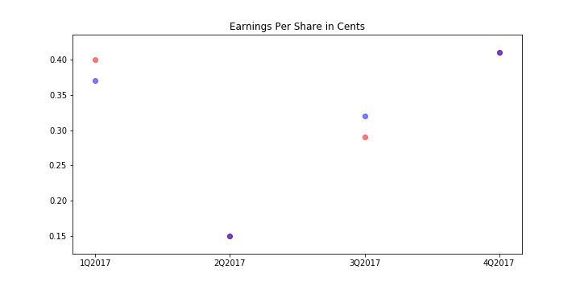
Comparison of Earnings Per Share
Each quarter, industry analysts predicted Netflix’s expected earnings per share; each quarter, these estimates were no more than 2 cents away from actuals
While stock price had a steady increase in 2017, earnings per share varied greatly between quarters
Q1 and Q4 were high performers at nearly 40 cents per share, while Q2 had a significant drop to 15 cents per share.

Slide 5
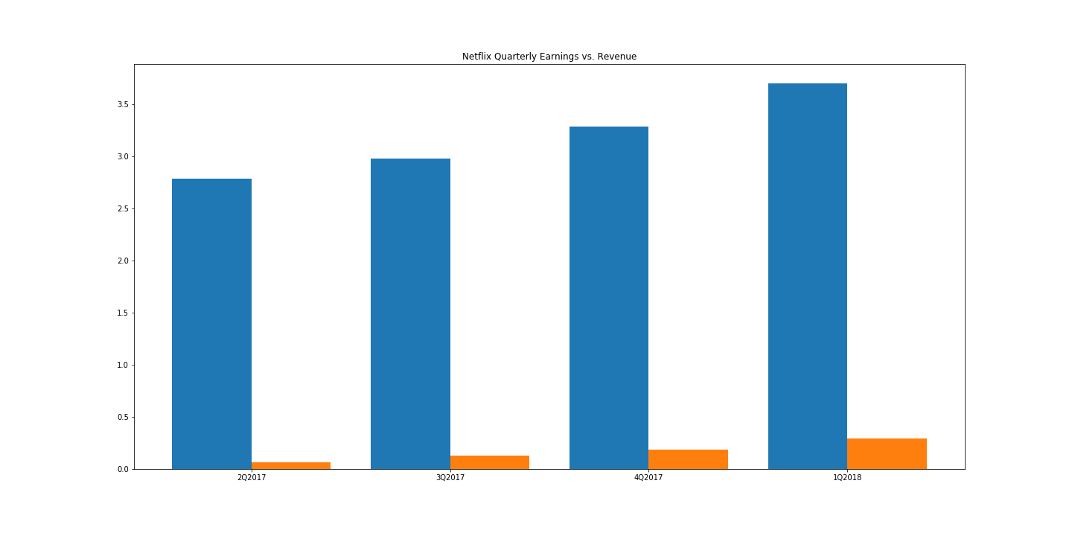
Netflix Revenue vs. Earnings (in $billions)
Each quarter, Netflix generates revenue from its business; earnings are the actual monies taken in after costs and taxes
2017 saw a steadily increasing trend for both revenue and earnings for Netflix
On average, earnings culminated at about 10% of revenue at the end of 2017

Slide 6
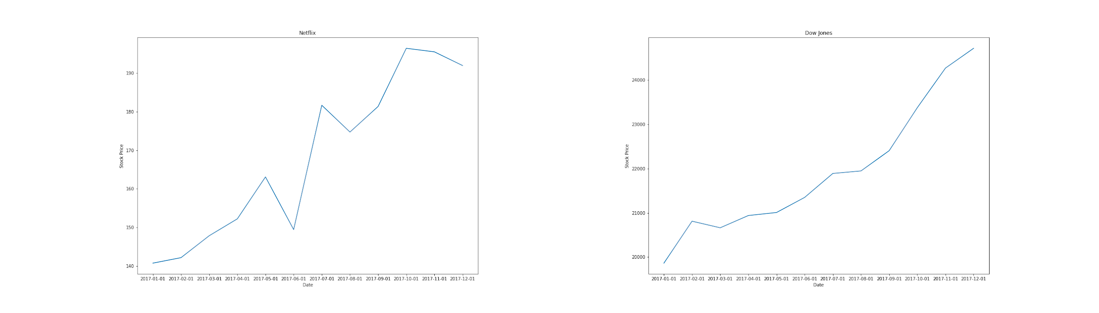
Netflix Stock Increase vs. DJIA
2017 was a strong year for most stocks, as indicated by the graph on the right that shows the performance of the Dow Jones Industrial Average
While the DJIA had a much smoother distribution, Netflix’s price fluctuated much more
Overall, Netflix was in line with the market’s average performance

